Slide 1
Persuasive Techniques in Advertising
Bandwagon Testimonial Emotional Appeal
Jingle Slogan

Slide 2
1. Bandwagon: Everybody has it or is doing it.
https://www.youtube.com/watch?v=uTKswo3WwVA&list=PL4OlQkTZbcmBsd5cZJPO7aGPmZh49tW_G

Slide 3
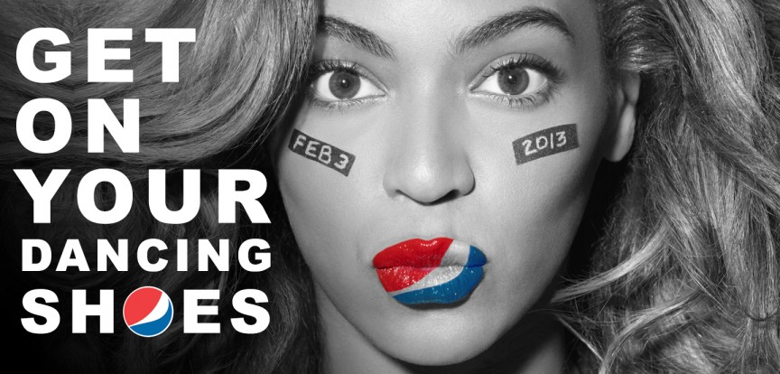
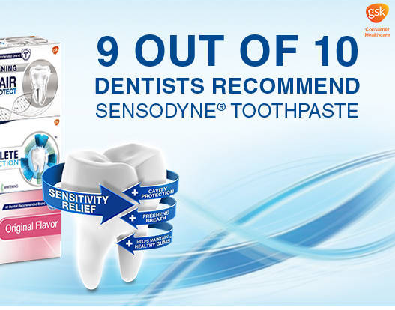
2. Testimonial: Products are endorsed by someone that is famous or an expert.
http://www.youtube.com/watch?v=Sfy8UYRhmpA

Slide 4
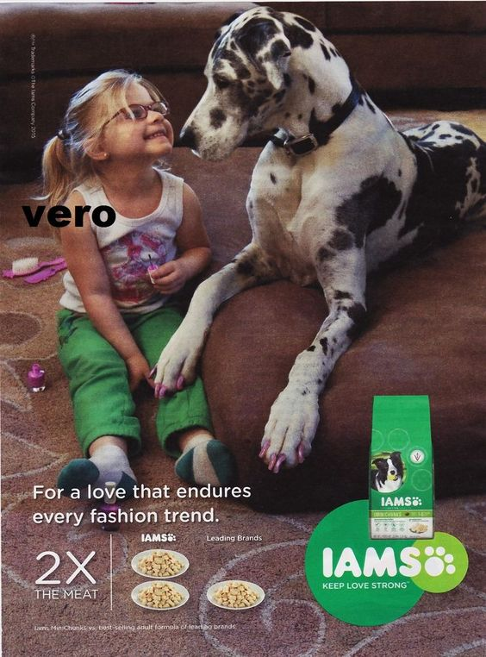
3. Emotional Appeal: Pulling at the heart strings to make someone feel strong emotions.

Slide 5
4. Jingle: A short song
Nation Wide is on your side
Like a good neighbor…State Farm is there!

Slide 6
5. Slogan: A short catchy phrase
Verizon Wireless “Can you hear me now?”
McDonald’s “I’m lovin’ it.”
Skittles “Taste the rainbow”

